Slide 1
Introduction to OpenAI Gym
09/03/2021

Slide 2
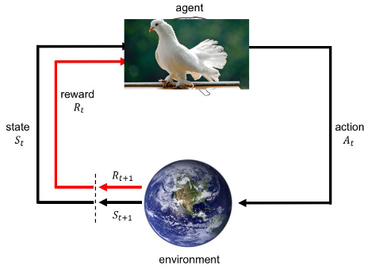
Basic RL Framework
OpenAI Gym
Notes:
reference to what you guys covered in lecture 1 and 2

Slide 3
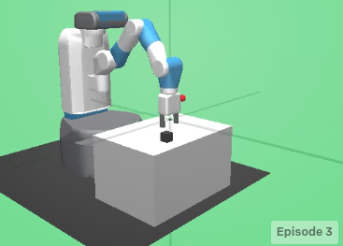
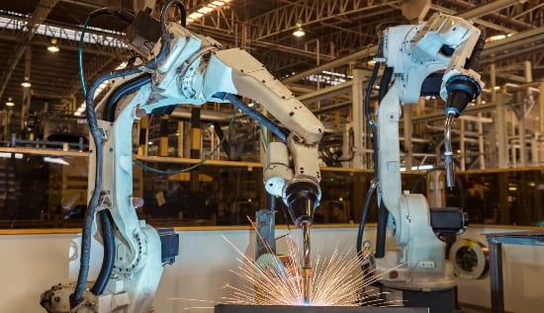
What is OpenAI Gym?
Vs
● A toolkit for testing RL algorithms on simplified examples
● Provides you with different environments
● Has a standard API to access these different environments
Notes:
Test new RL algorithms on simple, toy examples before moving to real world environments with much more serious consequences for mistakes
friction and impedance
no consequences for unexpected behavior
Can anyone try to guess what makes this mountain car environment challenging for RL algorithms to solve?

Slide 4
Why did we choose to use OpenAI gym?
● Open-source - large online community, you can modify the source code to fit your needs
● Intuitive API - easy to get started
● Widely used in RL research - common benchmark for RL papers
Notes:
large online community to ask questions and clear confusions
can easily download the source files in github and modify constraints, rewards,
we’ll go over in a few slides what the API looks like

Slide 5
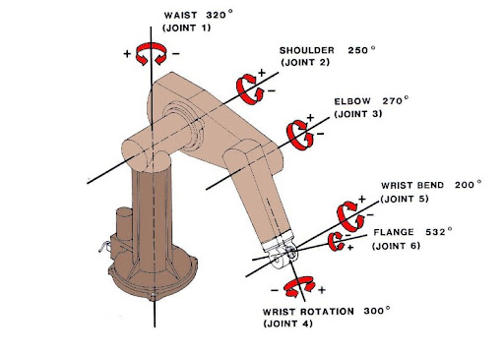
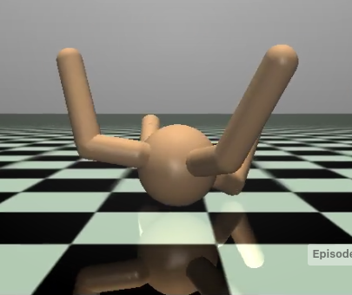
Action and State/Observation Spaces
● OpenAI gym environments have predefined state and actions, but…
● Key questions to ask when debugging RL in general:
● Does the state and action space make sense?
● What is the reward?
● Are there any constraints on state and action space?
● Should constraint violations be penalized?
● When should an episode terminate? Am I handling termination
correctly?
Notes:
If you were given this state and action space, could you solve this task?
Does the state space need to be augmented with extra info?
Are there any constraints on the action space?
When should an episode terminate?
is the agent in an irrecoverable state?
although OpenAI is quick and easy to setup, you need to make sure you understand the environment and task you are trying to solve and address issues with
that before looking for bugs in your RL algo

Slide 6
Demo
https://colab.research.google.com/drive/1TISfcs4ZRZJ0lg2g0KD7CdsW99HAcWb2?usp=sharing

Slide 7
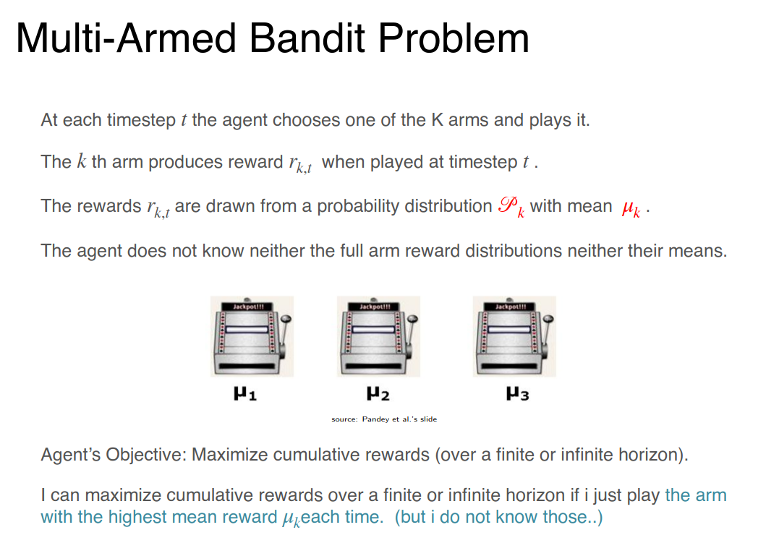
Bandits

